Slide 1
C300 FINAL EVALUATION
Team ID:
SOI-2024-0055
Team Members:
1. Peh Yi Feng Javier
2. Liaw Hong Da
3. Tan Hong Bin
4. Daniel Sanjay Sadhnani
Project ID:
SOI-2024-2410-0029
Project Title:
Students Survey Analysis Project
Supervisor:
Nimmy Varghese

Slide 2
Content
Introduction
Journey
Survey
Cleansing
Visualization
Clustering
Text Analytics
Predictive Model
Conclusion & Recommendations
Questions and Answers

Slide 3
Introduction
Student Survey Analysis involves creating and conducting a survey among students to gather comprehensive data on demographics, school performance, gaming habits, part-time work, co-curricular activities (CCA), satisfaction levels, career aspirations, and required skills.
The project aims to equip us with practical skills in data cleansing, visualization, clustering, and text analytics.
Tools that we will be using for this project are: Google Forms, Excel, and Python

Slide 4
Journey
Week 1-3
Clarify Survey Questions
Release Survey To Students
Gather 250 Responses
Tools Used: Google Forms
Week 6-7
Begin Data Visualisation
Based On Gaming , Part-Time , School Satisfaction , CCA
Tools Used: Tableau
Week 8-9
Begin Clustering
Used Numeric Columns For Clustering
Tools Used: Python
Week 4-5
Mid-Sem
Week 10-12
Week 1-3
Week 6-7
Week 8-9
Week 4-5
Begin Data Cleansing
Tools Used: KNIME, Excel
Mid-Sem Break
Restart On Data Cleansing & Visualisation
Tools Used: Python , Excel
Week 10-12
Begin Text Analysis, Text Clustering & Predictive Model
Tools Used: Python

Slide 5

Survey

Slide 6
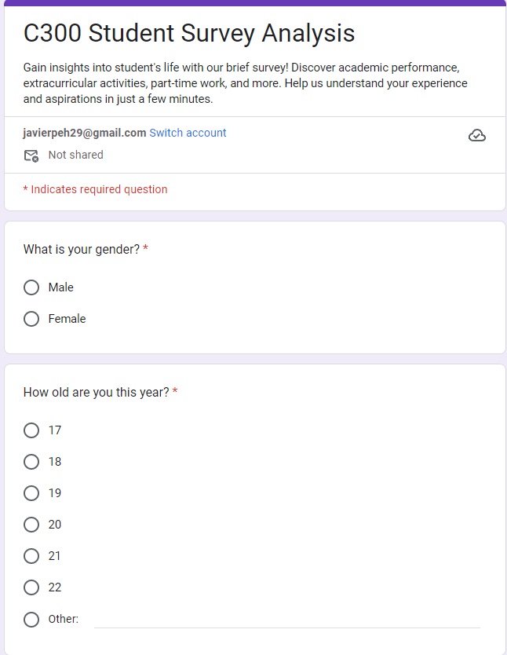
Survey - General Questions
Questions asked:
Gender
Age
Institution
Ethnicity
Religion
No. Of Siblings
Their Parent(s) work
Housing Type

Slide 7
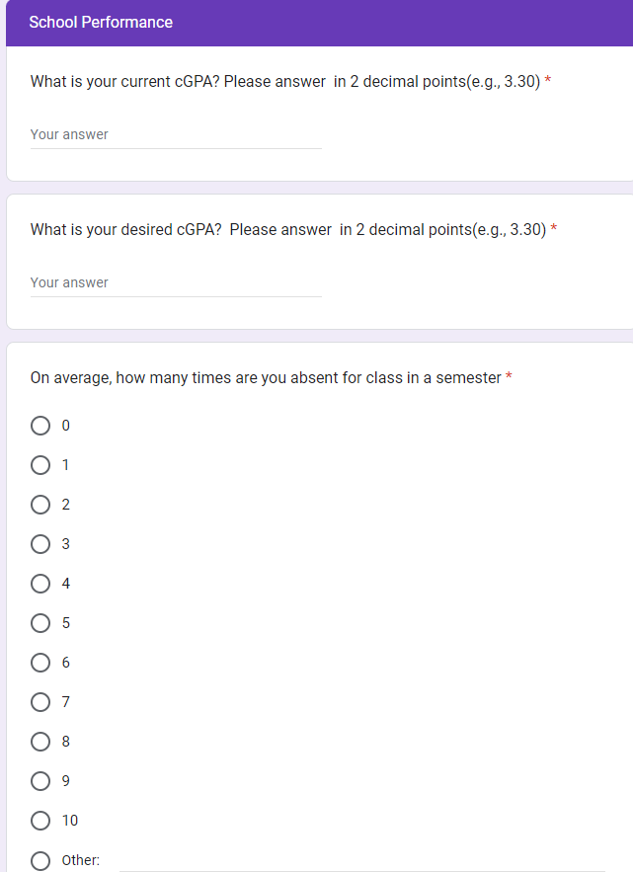
Survey - School Performance Questions
Questions asked:
Current GPA
Desired GPA
Absences Per Semester

Slide 8
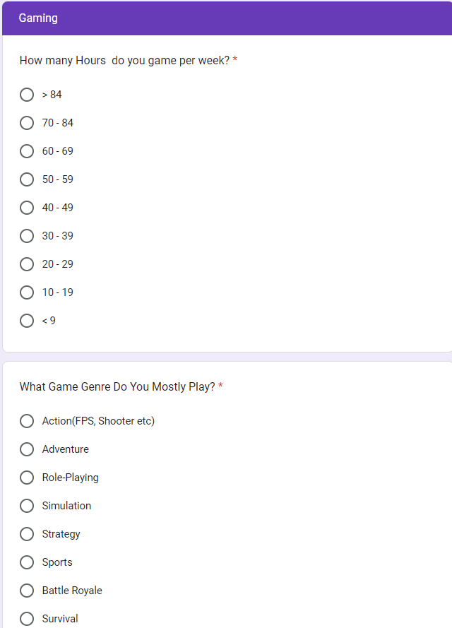
Survey - Gaming Questions
Questions:
Play Video Games?(No, skips)
Hours Spent Per Week
Most Played Genre
Play With Friends
Time Usually Start
Parent(s) stop them
Reason Started

Slide 9
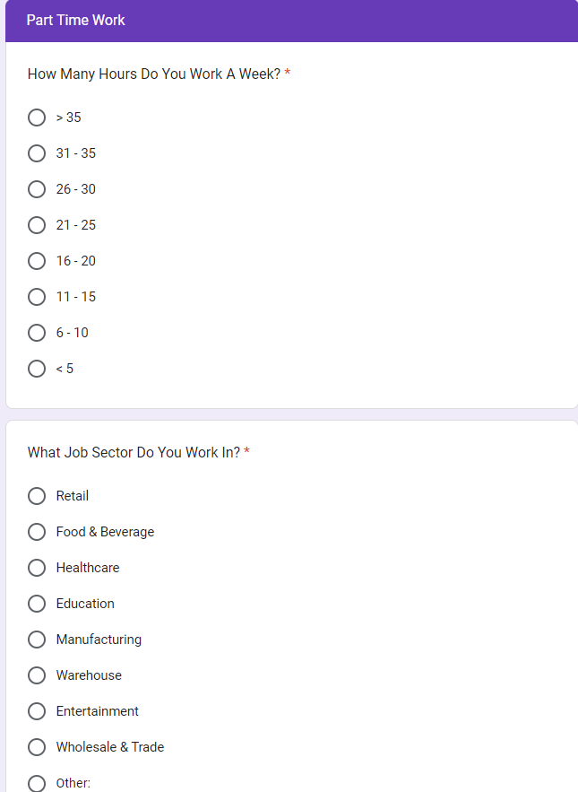
Survey - Part Time Work Questions
Questions asked:
Work Part-Time?(No, skips)
Hours Worked Per Week
Job Sector
Days Usually Work

Slide 10
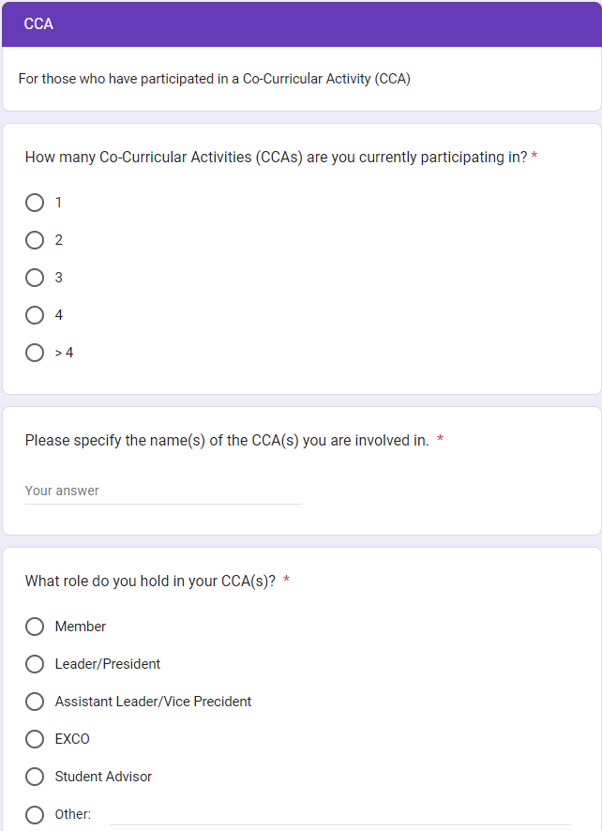
Survey - CCA Questions
Questions asked:
Participate in CCA?(No, skips)
How many CCA
What CCA
Role In CCA
Hours spent in CCA

Slide 11
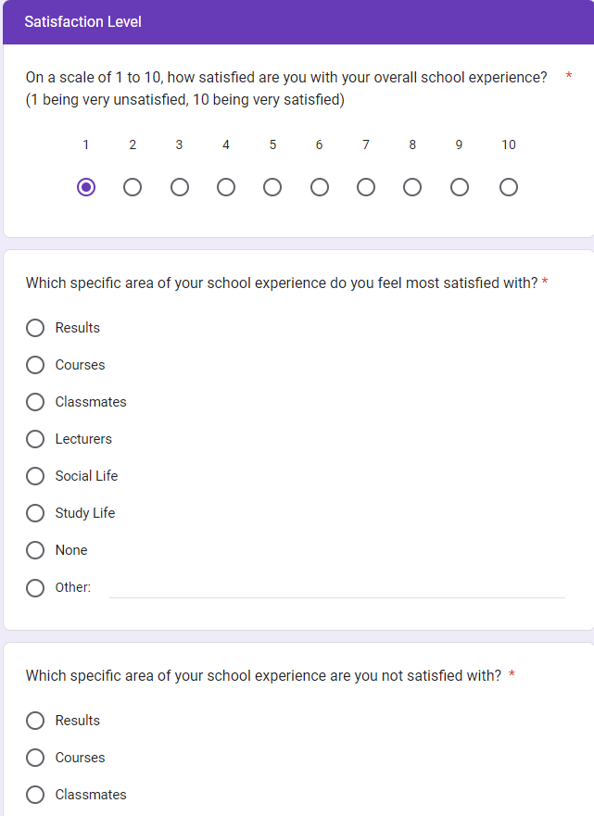
Survey - School Satisfaction Questions
Questions asked:
How satisfied with School Experience
Which area most satisfied
Which area most unsatisfied
Rate School Support(1-10)
School fosters sense of belonging

Slide 12
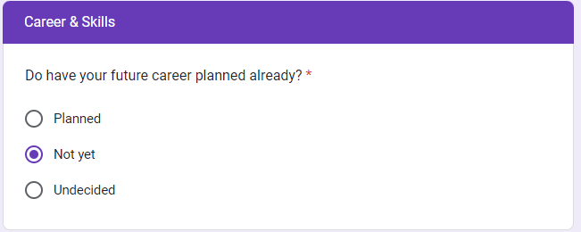
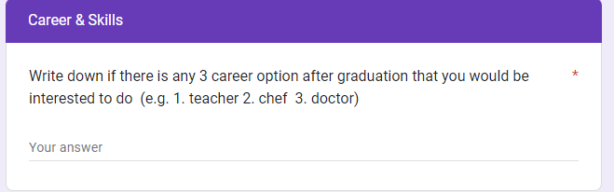
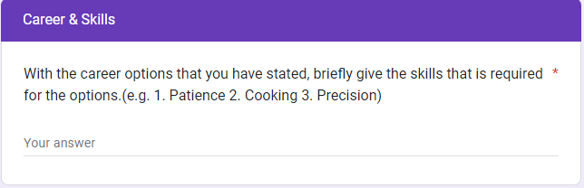
Survey - Career Option Questions
Questions asked:
Future career planned?
Share 3 Career Options(Decided/Interested)
Share 3 Required Skills for the Jobs Listed

Slide 13
CLEANSING

Slide 14
Data Cleansing - Steps Taken
Daniel
filtered out columns that are not in use(timestamp column)
replaced ? values with no
filtered out rows that had invalid data/responses
replaced certain data with another type of data (eg. 1 half sibling 4 siblings to 5 siblings)
set string values in gpa column to double
set gpa to only have values between 0 to 4( filtered out the rest)
replaced string values in int/double columns with mean of data
replaced null values with something more appropriate (eg. for game hours, if null replace with 0)
259 Rows To 201 Rows
37 Columns To 36 Columns

Slide 15
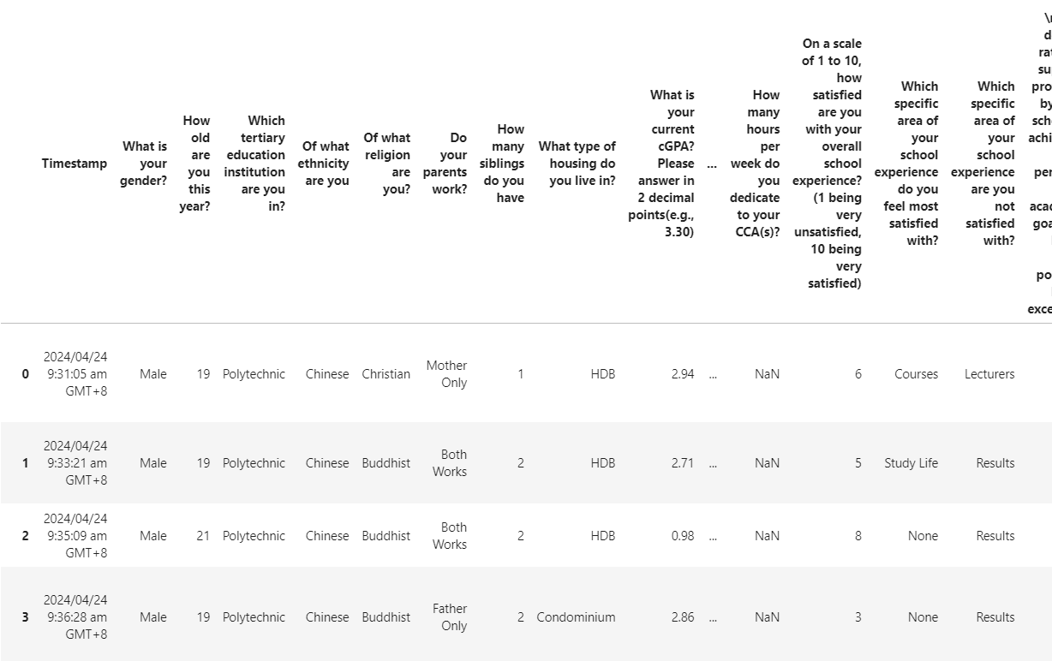
BEFORE (Data Cleansing)
Daniel

Slide 16
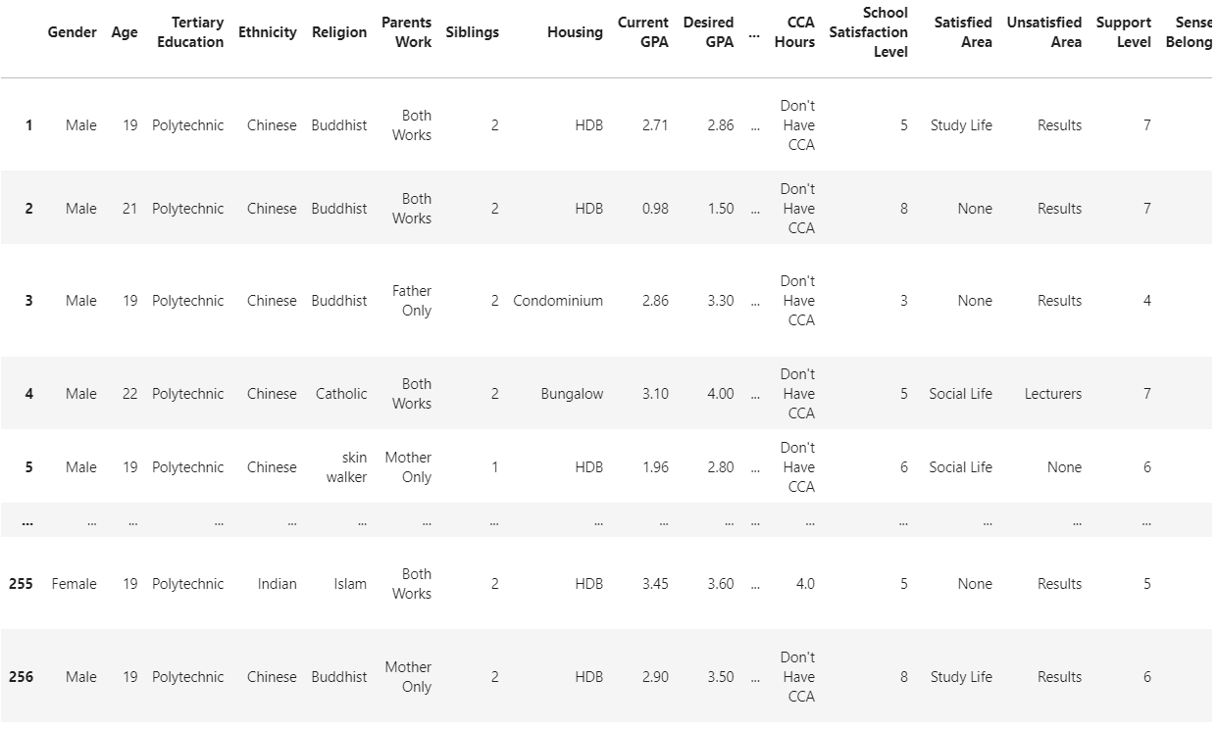
AFTER (Data Cleansing)
Daniel

Slide 17
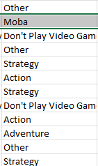
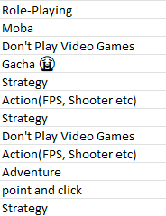
Cleansing - Continuation of Cleansing on Excel
Javier
Columns with multiple variables, grouped minor ones as “Others”
Game Genre Before
Game Genre After

Slide 18
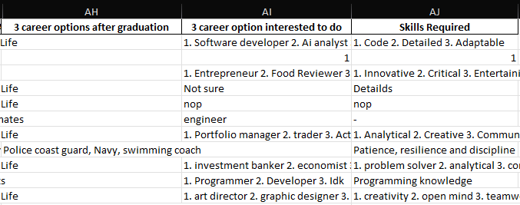
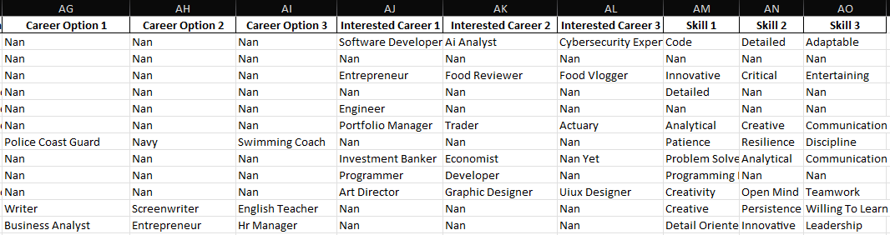
Cleansing - Continuation of Cleansing on Excel
Javier
Split them into 3 columns each in terms of order written
Took out all the ‘1. 2. 3.’ and commas to standardize
Filled empty cells with ‘Nan’

Slide 19
VISUALIZATION
ABSENCES

Slide 20
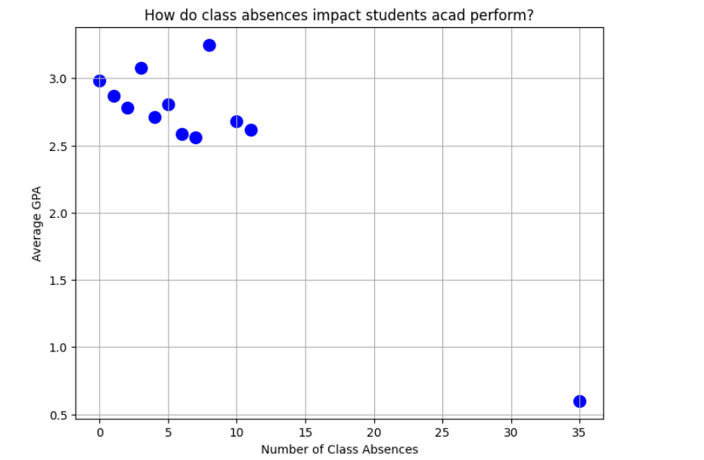
VISUALIZATION - ABSENCES
Daniel
Insights:
Most Students who had Absences number from 0-12 Had an Average GPA ranging from 2.5 to 3.5
One Student had an Absences number of 35 and had a GPA of 0.6
One Outlier lies in this Data Of Average GPA and Absences

Slide 21
VISUALIZATION
GAMING

Slide 22
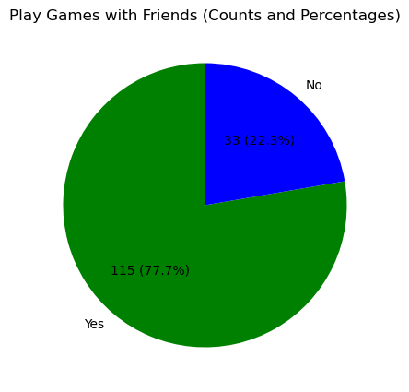
VISUALIZATION - GAMING
Javier
Play With Friends
115(77.7%)
Play Alone
33(22.3%)

Slide 23
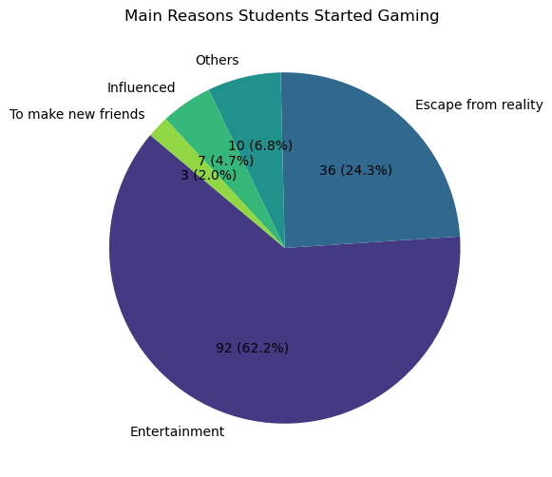
VISUALIZATION - GAMING
Javier
Most Popular Reason
Entertainment: 92(62.2%)
Least Popular Reason
To make new friends: 3(2%)

Slide 24
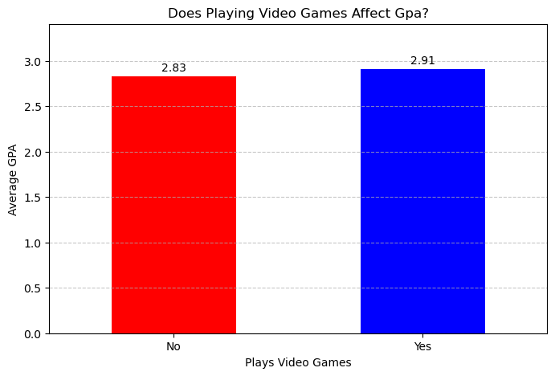
VISUALIZATION - GAMING
Javier
Average GPA of Play Games
2.91
Average GPA of Don’t Play Games
2.83

Slide 25
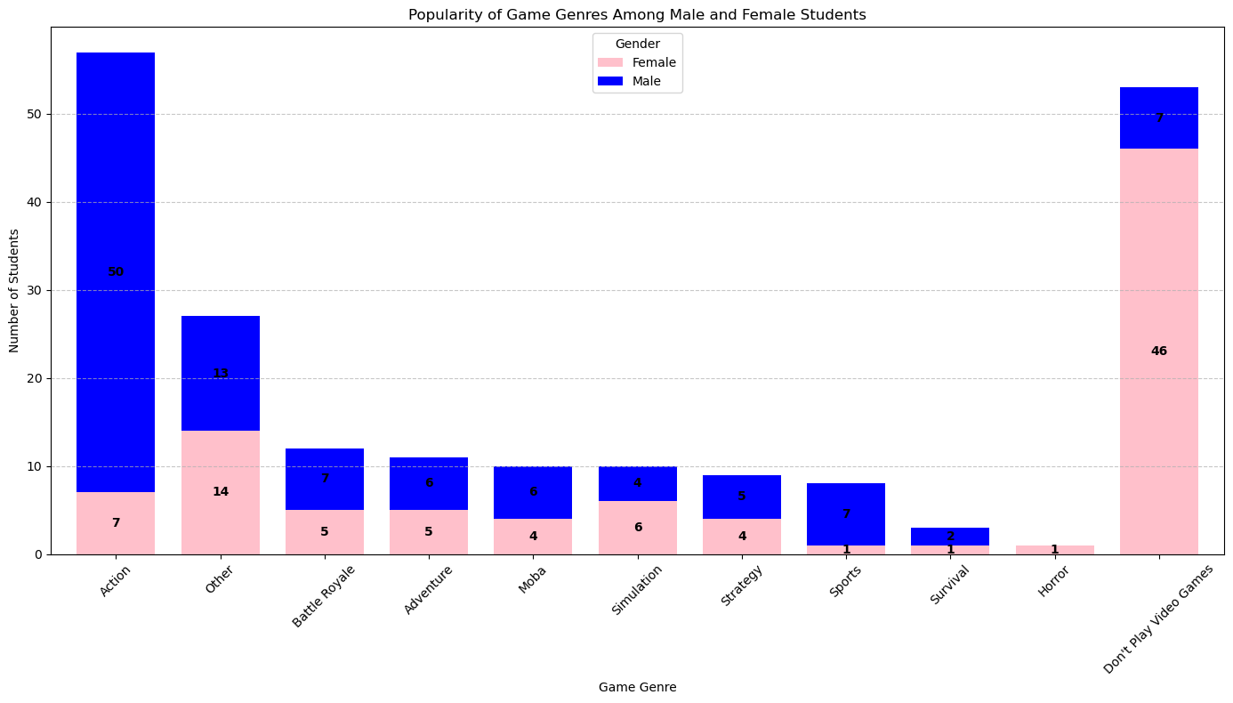
VISUALIZATION - GAMING
Javier
Most Popular Game Genre
Action: 34%(57) of those that play games
Most Popular Amongst Males
Action: 50%(50)of males that play games
Most Popular Amongst Females
Others: 29%(14) of females that play games
Don’t Play Games
26%(53) of all responses
51%(46) of Females
6%(7) of Males

Slide 26
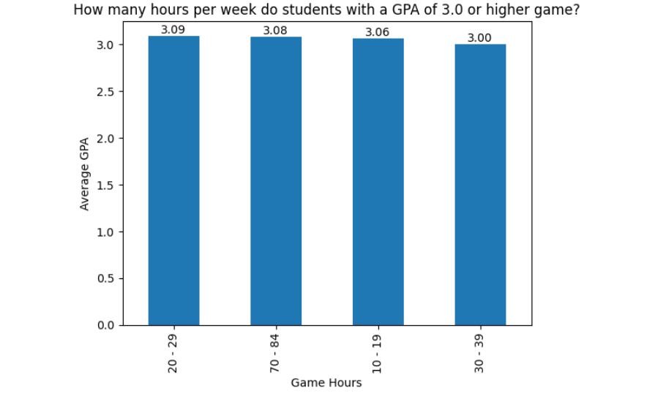
VISUALIZATION - GAMING
Daniel
Insights:
Students With a Game Hour Range of 20-29 , 70-84 , 10-19 , 30-39 are the only ones with a GPA of 3.0 and above
Students with a Game Hour Range of 20-29 had the highest average GPA with 3.09

Slide 27
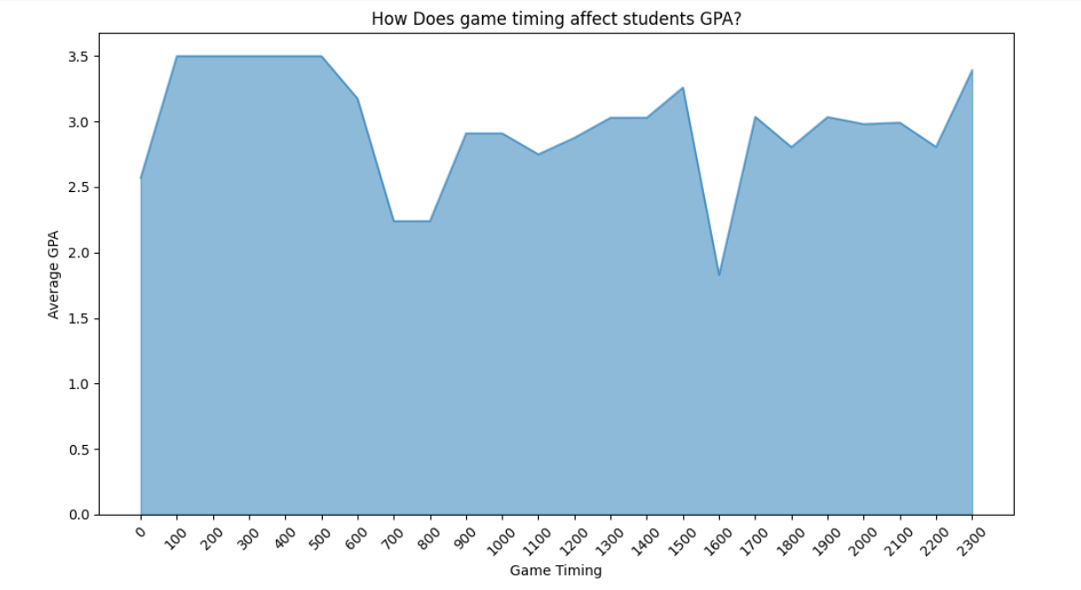
VISUALIZATION - GAMING
Daniel
Insights:
Students With a Game Timing from 1Am - 5Am Had the highest average GPA of 3.5
Students with a Game Timing at 4PM , Had the lowest Average GPA of 1.83

Slide 28
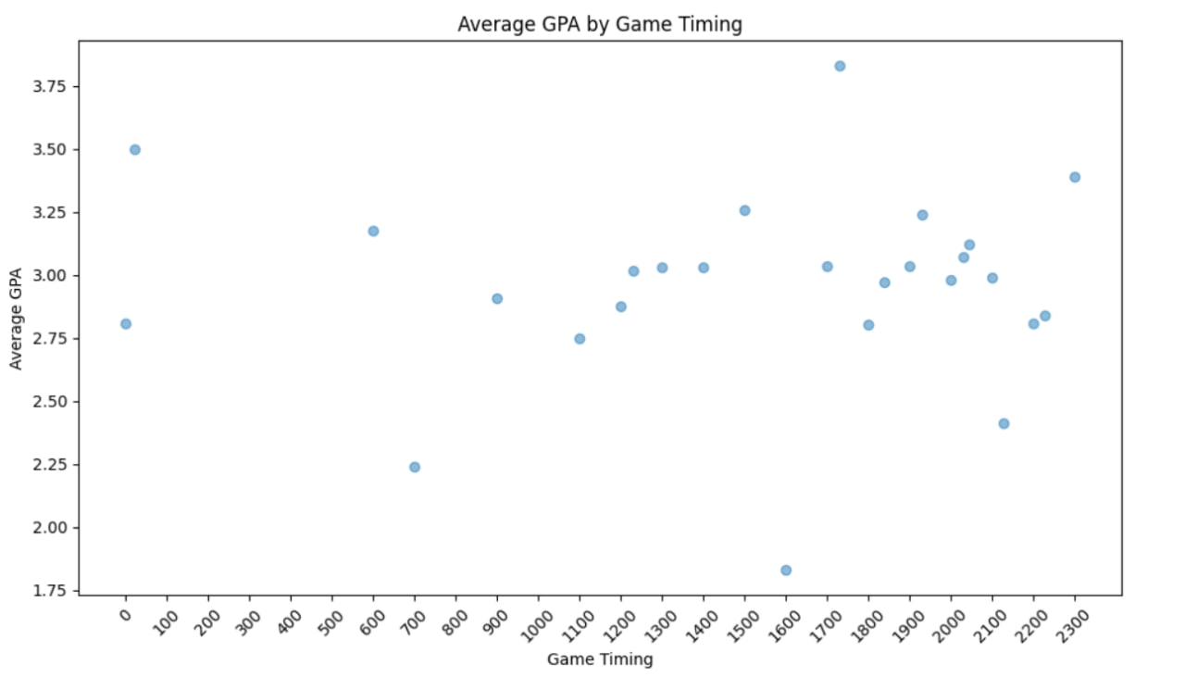
VISUALIZATION - GAMING
Hong Bin
Insights:
Students who games around 6PM has the highest Average GPA of 3.75
Students who game at 4PM have the lowest Average GPA of 1.83

Slide 29
VISUALIZATION
SATISFACTION

Slide 30
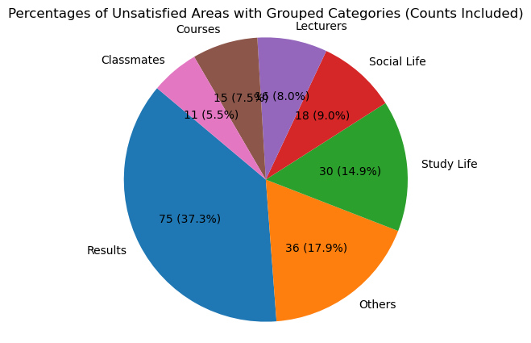
VISUALIZATION - SATISFACTION
Javier
Most common area
Results: 75(37.3%)
Least common area
Classmates: 11(5.5%)

Slide 31
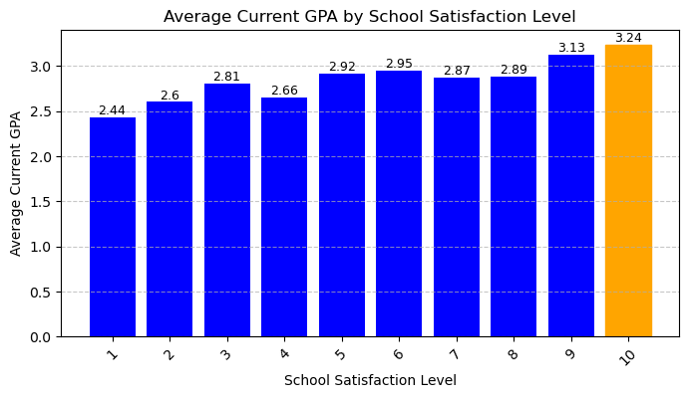
VISUALIZATION - SATISFACTION
Javier
Highest Avg GPA
Satisfaction Level 10: 3.24
Lowest Avg GPA
Satisfaction Level 1: 2.44

Slide 32
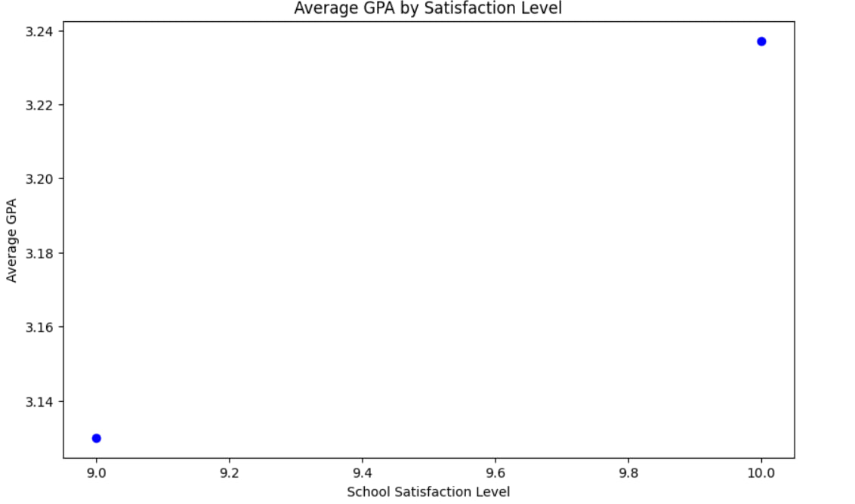
VISUALIZATION - SATISFACTION
Hong Bin
Insights:
Students who are more satisfied with school tend to have a higher Average GPA of 3.24 while unsatisfied students have below 3.14 Average GPA

Slide 33
VISUALIZATION
CCA

Slide 34
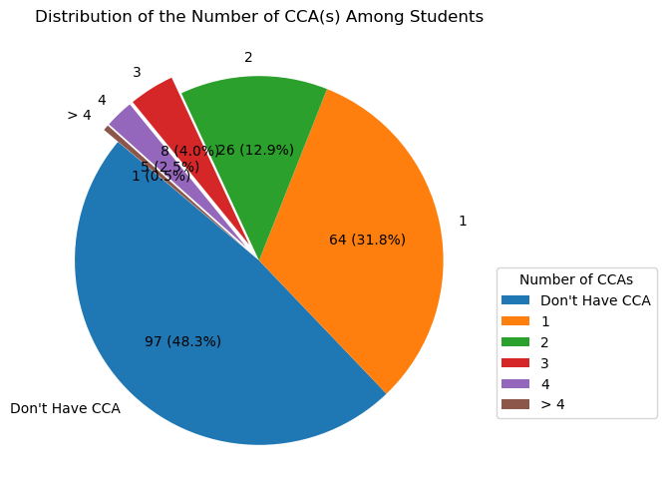
VISUALIZATION - CCA
Javier
Don’t Have CCA
97(48.3%)
Common Amount for with CCA
1 CCA: 64(31.8%)

Slide 35
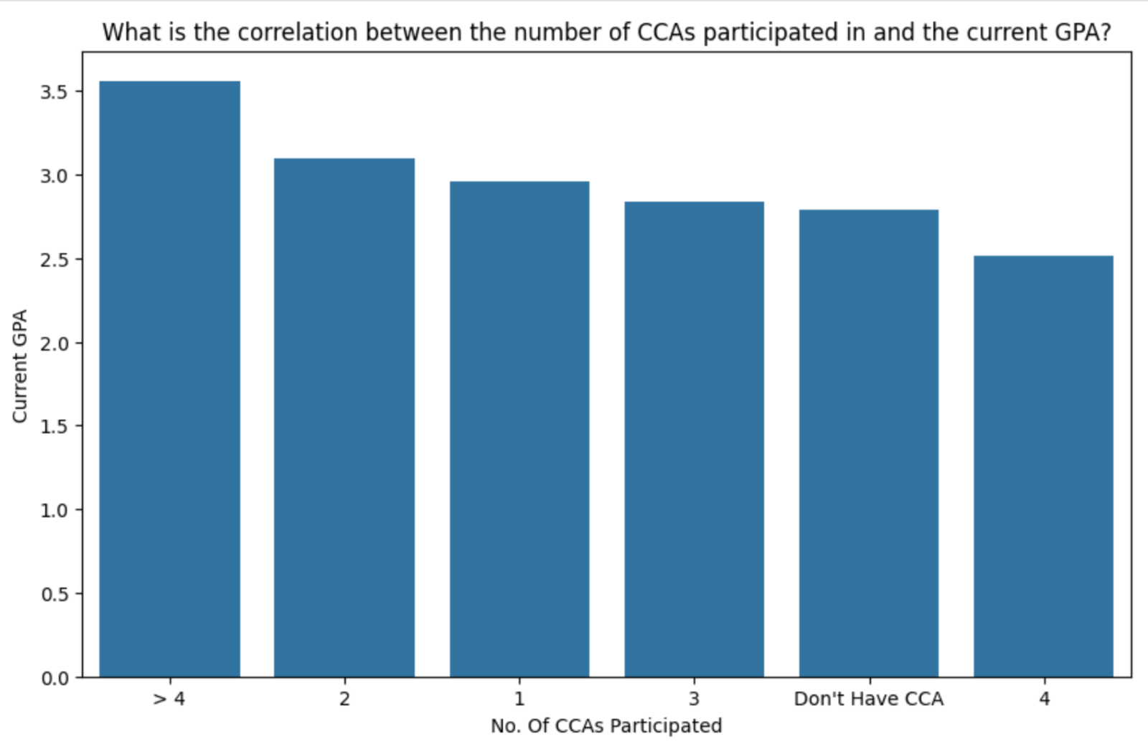
VISUALIZATION - CCA
Hong Da
Insights:
Students participating in more than 4 CCAs to have the highest GPA, averaging around 3.5.
Students participating in 3 or less CCAs have a slightly lower GPA, around 3.0.
Students who do not participate in any CCA have a lower average GPA, approximately 2.8.
Conclusion:
Number of CCAs is does not directly affect GPA. It is possible for students with more CCAs to have a high GPA

Slide 36
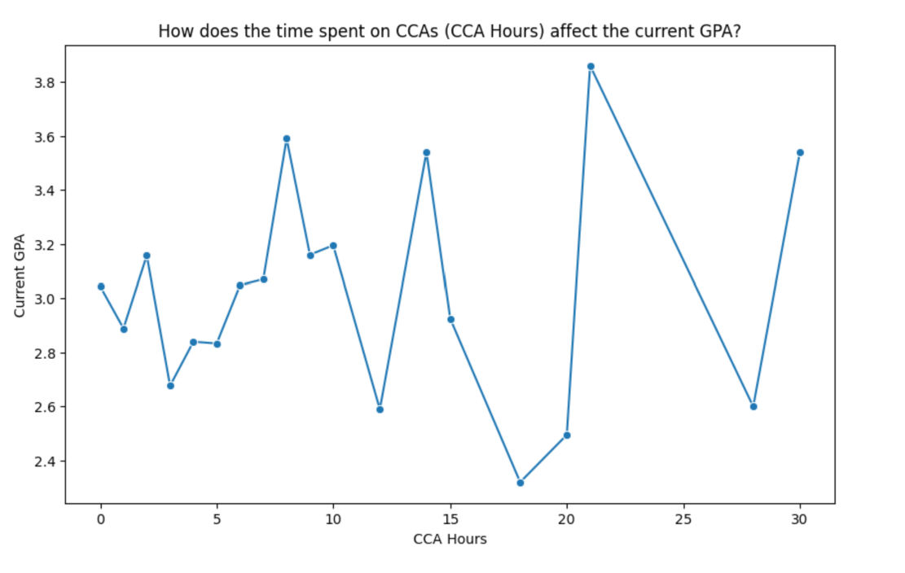
VISUALIZATION - CCA
Hong Da
Insights:
Students spending 0 to 10 hours on CCAs have varying GPAs, mostly fluctuating around 2.8 to 3.2.
A notable decrease in GPA is observed for students spending around 15 hours on CCAs, with GPAs dropping to approximately 2.6.
Students spending around 20 hours on CCAs show a significant increase in GPA, peaking at around 3.8.
Beyond 20 hours, there are significant fluctuations in GPA
Conclusion:
Time spent in CCA does not directly affect GPA score.

Slide 37
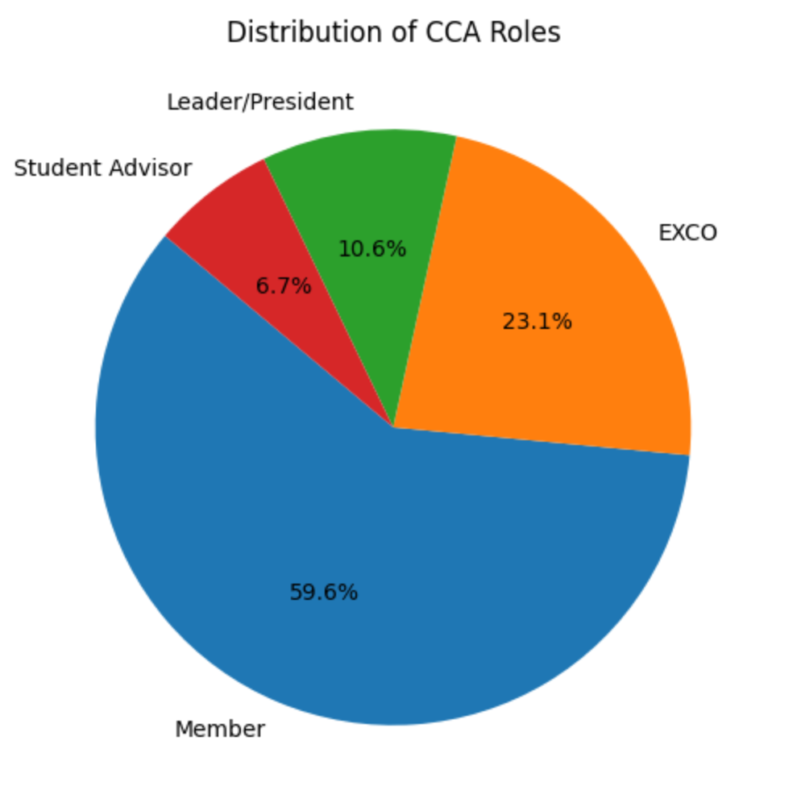
VISUALIZATION - CCA
Hong Da
Insights:
A significant majority of students (59.6%) are members of their CCAs without holding any specific leadership roles.
23.1% of students hold roles in the Executive Committee (EXCO),
10.6% of students are leaders or presidents of their CCAs

Slide 38
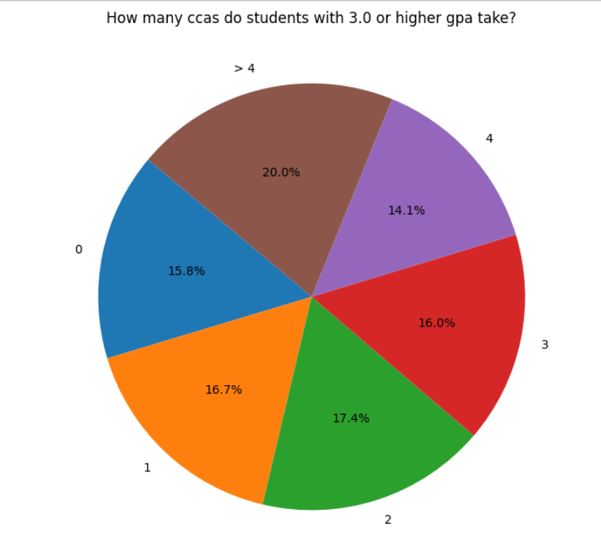
VISUALIZATION - CCA
Daniel
Insights:
20% of Students with a GPA Of Higher than 3.0 Take more than 4 CCAs
17.4 % of Students with a GPA of higher than 3.0 Take 2 CCAs
16.7% of Students with a GPA of higher than 3.0 Take 1 CCA
16% of Students with a GPA of higher than 3.0 Take 3 CCAs
15.8% of Students with a GPA of higher than 3.0 Have 0 CCAs
14.1% of Students with a GPA of higher than 3.0 Have 4 CCAs

Slide 39
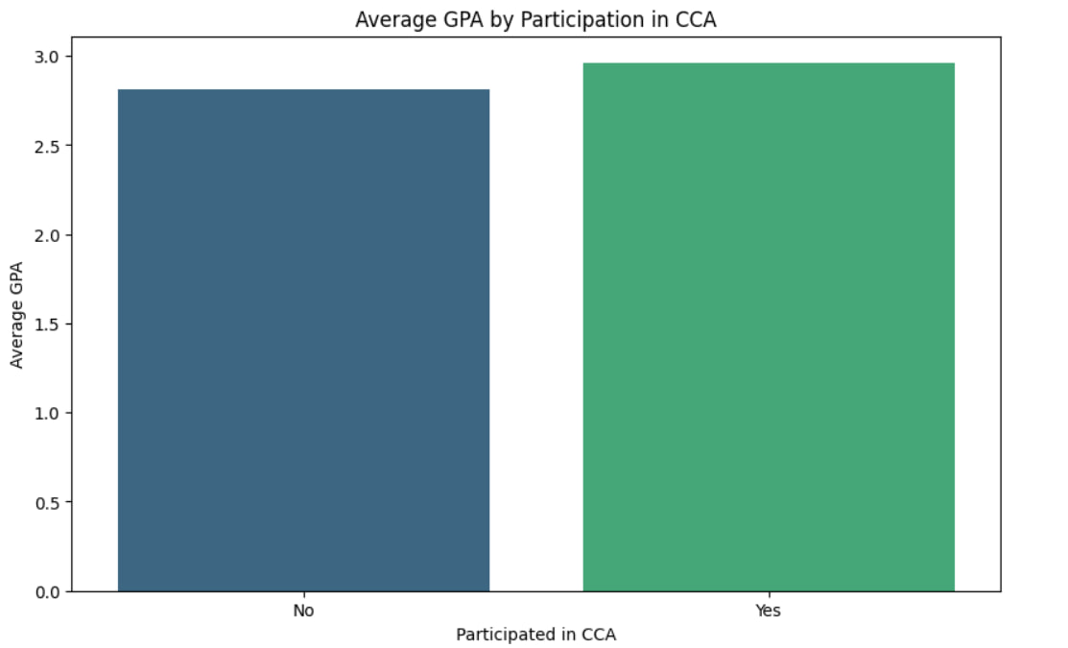
VISUALIZATION - CCA
Hong Bin
Insights:
Students who participates in CCAs have higher Average GPAs than those who does not participate in CCAs

Slide 40
VISUALIZATION
PART-TIME JOB

Slide 41
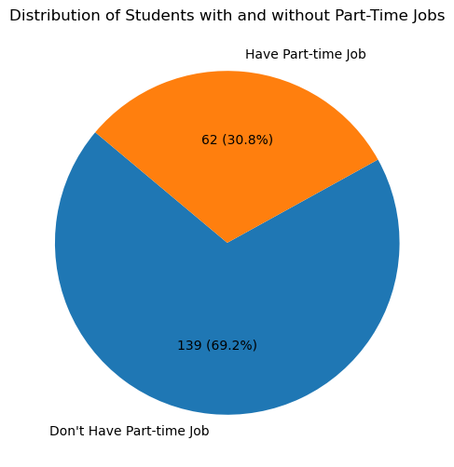
VISUALIZATION - PART-TIME
Javier
Have Part-Time Job
62(30.8%)
Don’t Have Part-Time Job
139(69.2%)

Slide 42
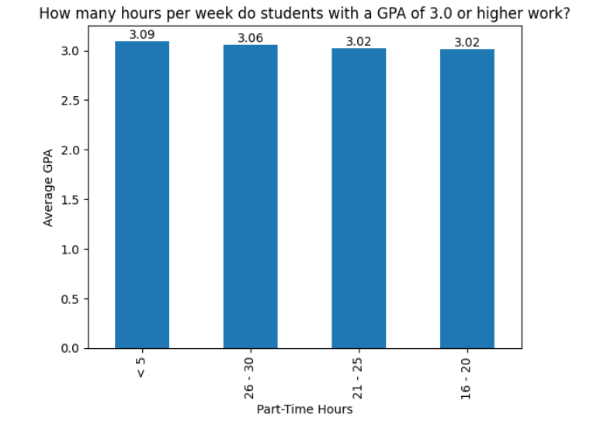
VISUALIZATION - PART-TIME
Daniel
Insights:
Students With a Part-Time Hour Range of <5 , 26-30 , 21-25 , 16-20 are the only ones with a GPA of 3.0 and above
Students with a Part-Time Hour Range of <5 had the highest average GPA with 3.09

Slide 43
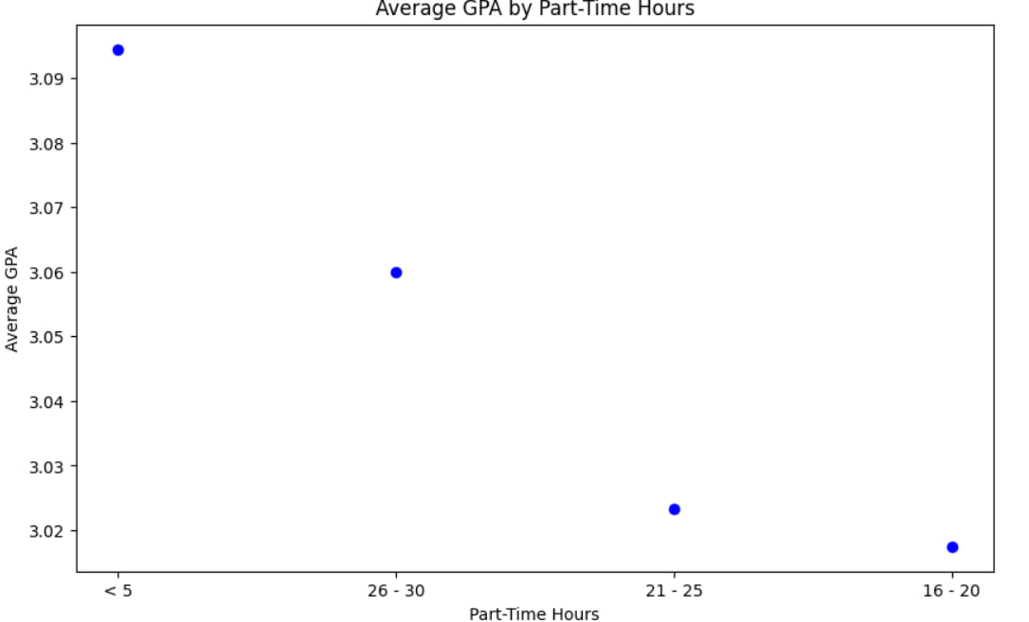
VISUALIZATION - PART-TIME
Hong Bin
Insights:
Students who work less than 5 hours has the highest Average GPA of above 3.09

Slide 44
CLUSTERING

Slide 45
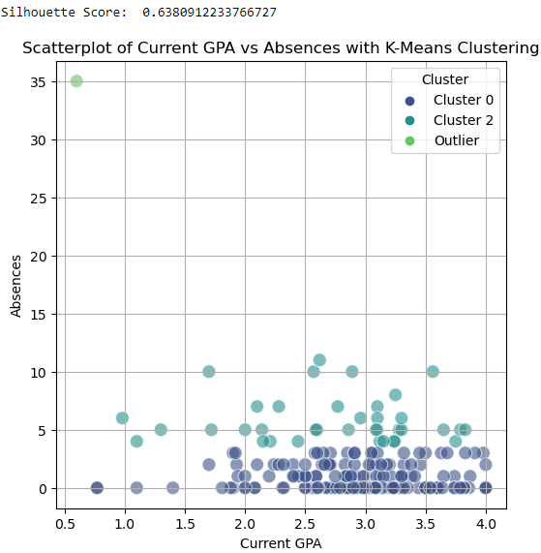
CLUSTERING - K-MEANS
Javier
X-axis: Current GPA
Y-axis: Absences
Clusters: 3
Silhouette score: 0.638

Slide 46
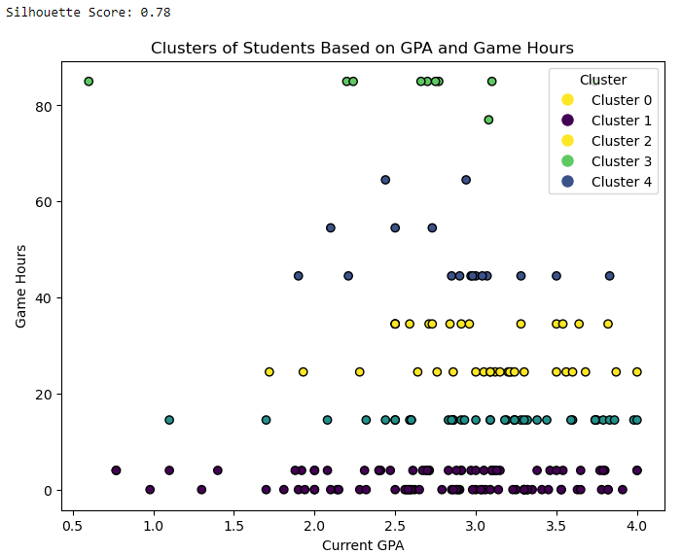
CLUSTERING - K-MEANS
Javier
X-axis: Current GPA
Y-axis: Game Hours(Average of each range)
Clusters: 5
Silhouette score: 0.78

Slide 47
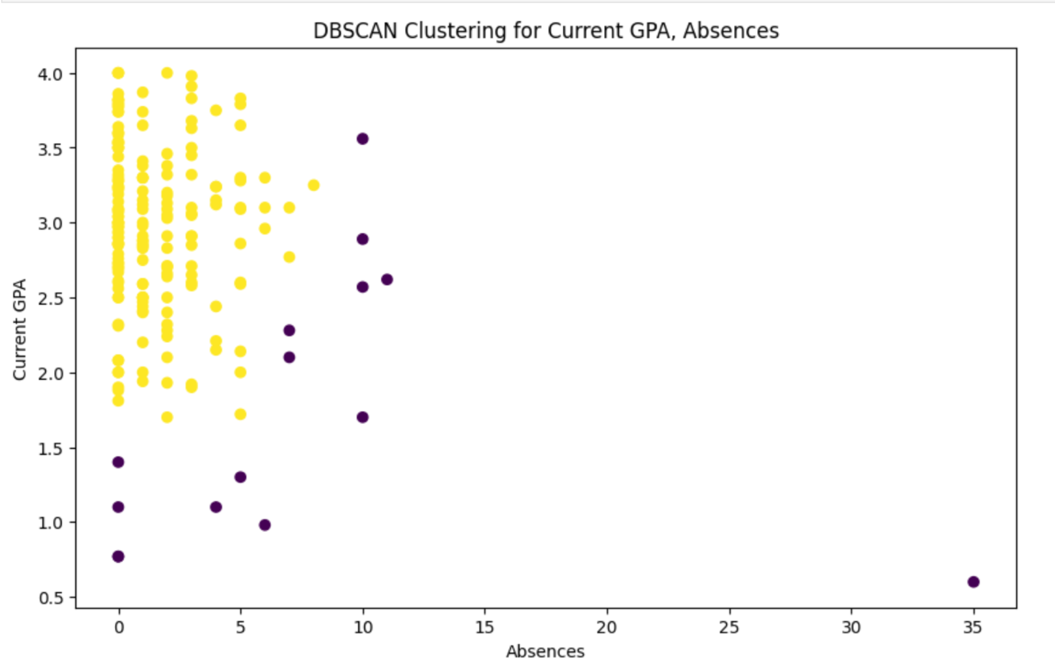
CLUSTERING - DBSCAN
Hong Da
X-axis: Absences
Y-axis: Current GPA
Clusters: 2
Silhouette Coefficient: 0.58

Slide 48
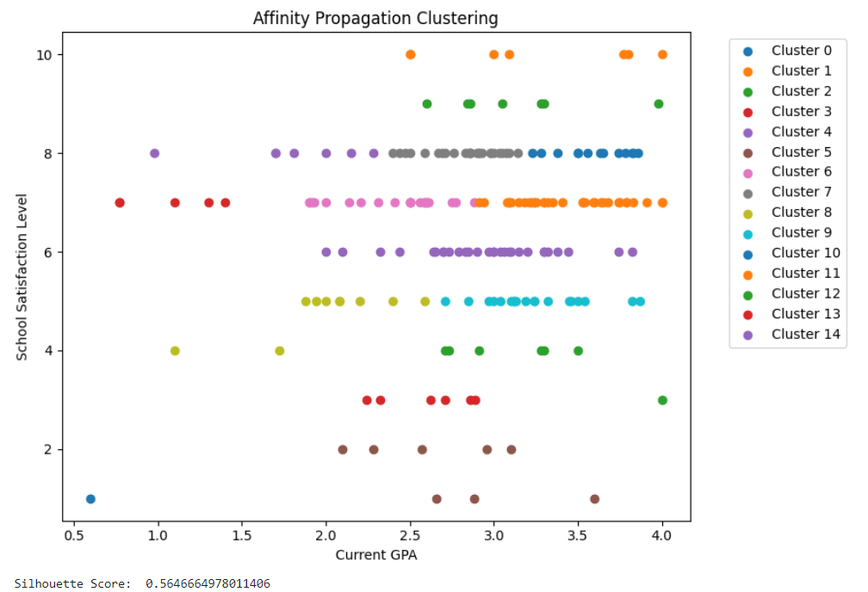
CLUSTERING - AFFINITY PROPAGATION
Daniel
Insights:
14 Different Clusters Based On the attributes Current GPA and School Satisfaction Level
Silouette Score of 0.56 with 14 clusters indicating that the cluster is average and can be better

Slide 49
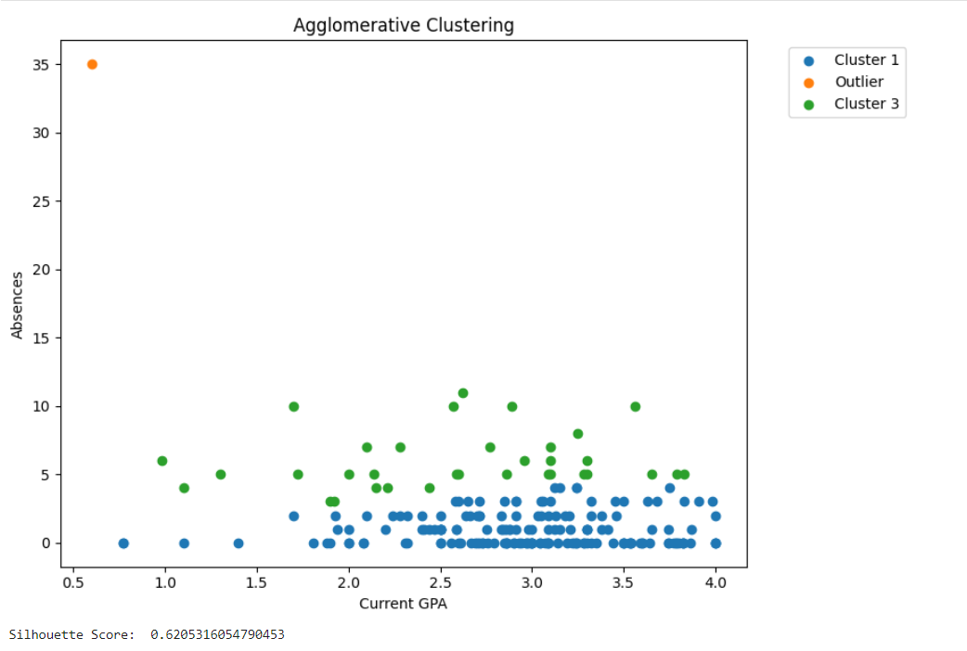
CLUSTERING - AGGLOMERATIVE CLUSTERING
Daniel
Insights:
Cluster 1 represents Students with a GPA of 0.7 To 4.0 and an Absence rate of 0 To 3
Cluster 2 represents Students with a GPA of 1.0 To 4.0 and An Absence rate of 4 To 10
One Outlier with a GPA of 0.5 And an Absence Rate of 35
Silouette Score of 0.62 with 3 clusters indicating cluster is Good

Slide 50
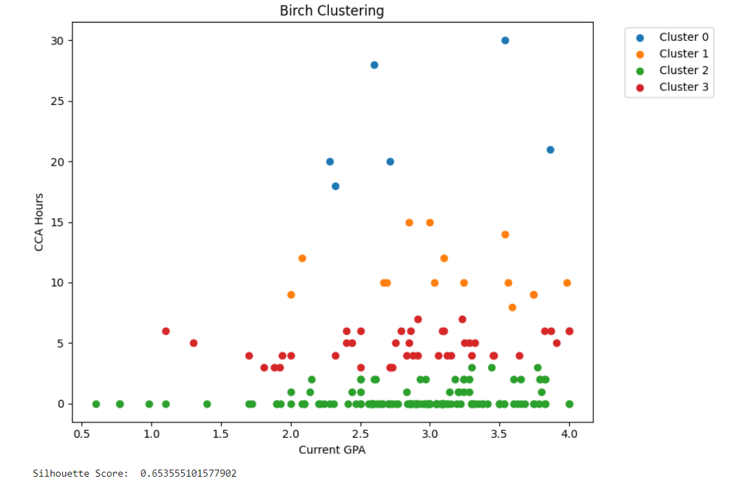
CLUSTERING - BIRCH CLUSTERING
Daniel
Insights:
Cluster 0 Represents Those with GPA of 2.2 to 4.0 and CCA Hours of 17 to 30
Cluster 1 Represents Those with GPA of 2.0 to 4.0 and CCA Hours of 5 to 15
Cluster 2 Represents Those with GPA of 0.5 to 4.0 and CCA Hours of 0 To 3
Cluster 3 Represents Those with GPA of 1.0 to 4.0 and CCA Hours of 2 To 7
Silouette Score of 0.65 with 4 clusters Indicating clustering is good

Slide 51
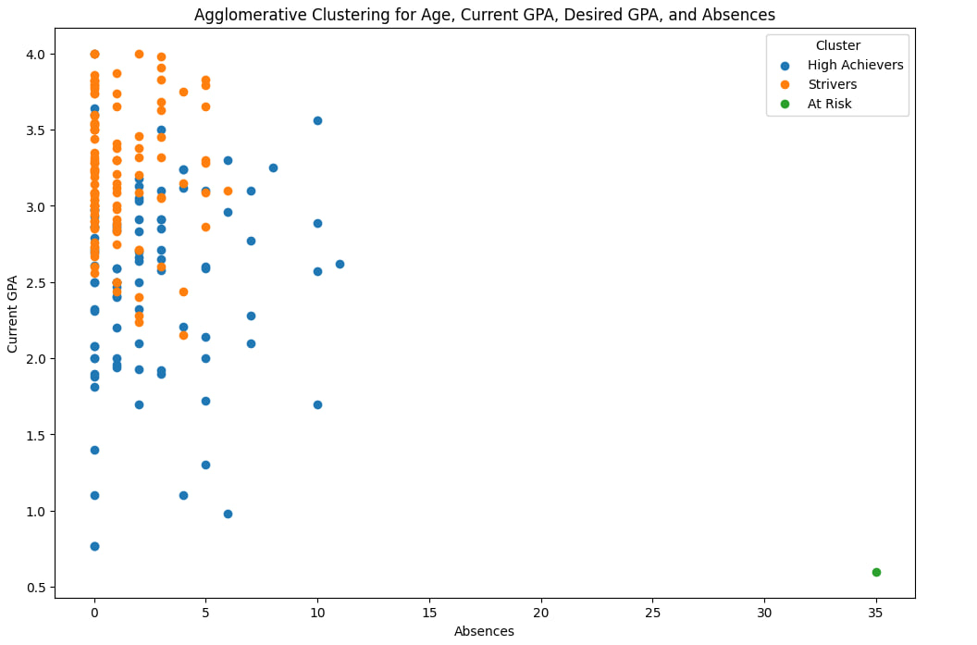
CLUSTERING - AGGLOMERATIVE CLUSTERING
Hong Bin
Insights:
The High achievers who are in blue have generally higher GPAs with fewer absences between 0 to 10 absences (clustered by consistent academic performance and regular attendance)
The Strivers who are in orange have GPAs that ranges from 2.0 to 3.5 with absences that are similar to High Achievers (Clustered by students who performed well but not at the top level)
The At Risk who are in green have very low GPAs with a notable outlier with high absences around 35. (Clustered by students who might be struggling academically and with their high number of absences which contributed to their low performance

Slide 52
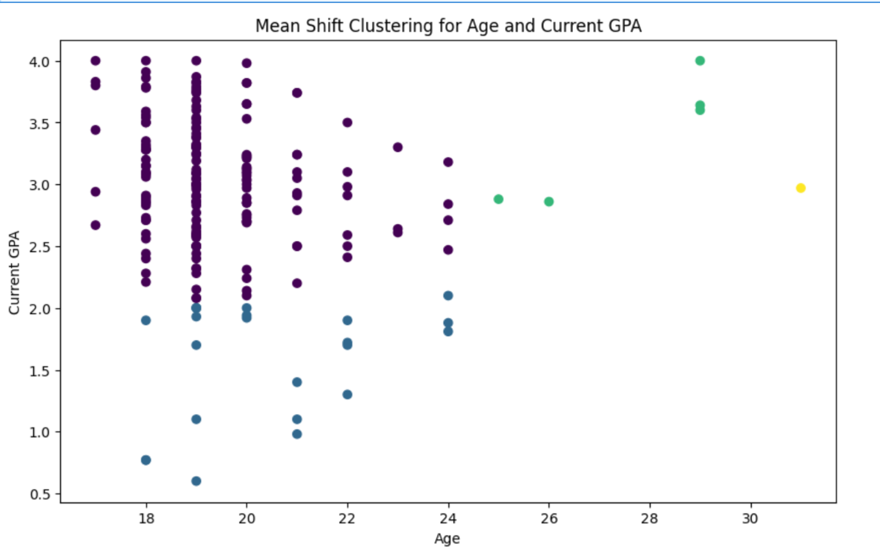
CLUSTERING - MEAN SHIFT
Hong Da
X-axis: Age
Y-axis: Current GPA
Clusters: 5
Silhouette Coefficient: 0.56

Slide 53
TEXT ANALYTICS (MINING)

Slide 54
TEXT MINING - Preparation
Javier
Replace ‘Nan’ with ‘NaN’(actual missing values)
Clean text with extra spacings
Aggregate the columns, etc ‘Career Option 1,2,3’ all into 1 column
Count values individually in each column
Create frequency dictionaries for the aggregated data

Slide 55
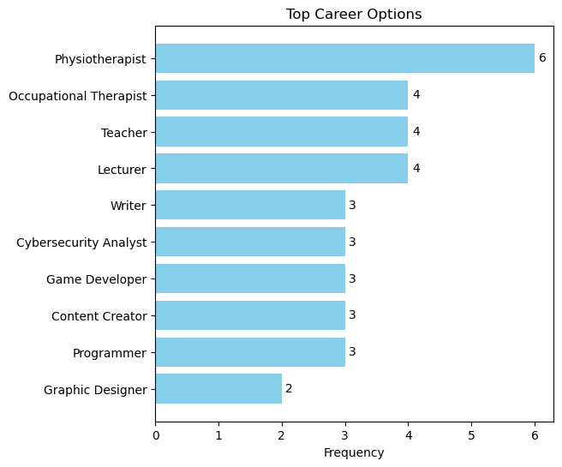
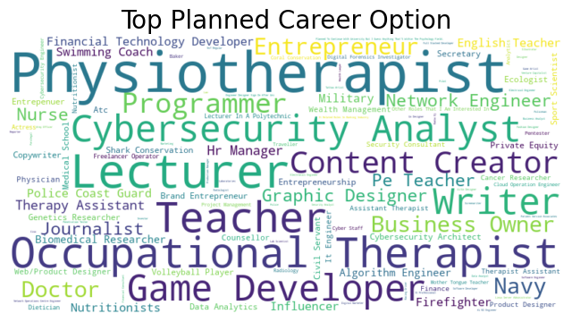
TEXT MINING - PLANNED CAREER
Javier
Insight: Physiotherapist is the top career option for students who mentioned they have their future career planned

Slide 56
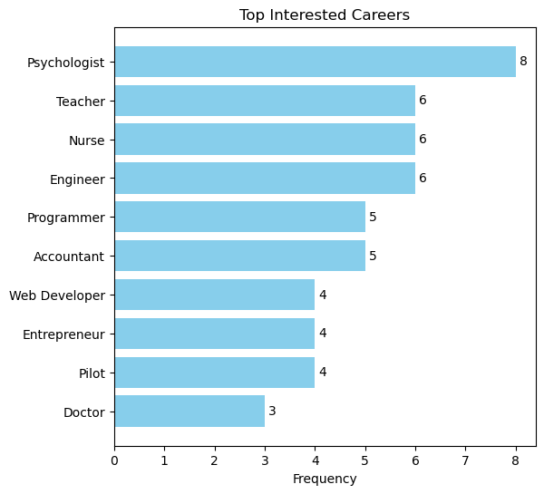
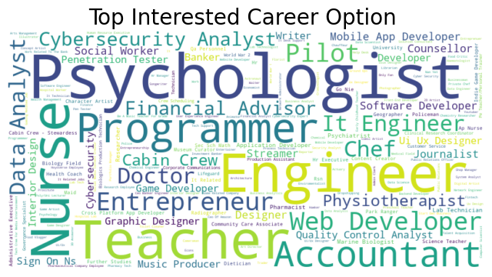
TEXT MINING - INTERESTED CAREER
Javier
Insight: Psychologist is the top career option for students have not planned or are indecisive of their future career options

Slide 57
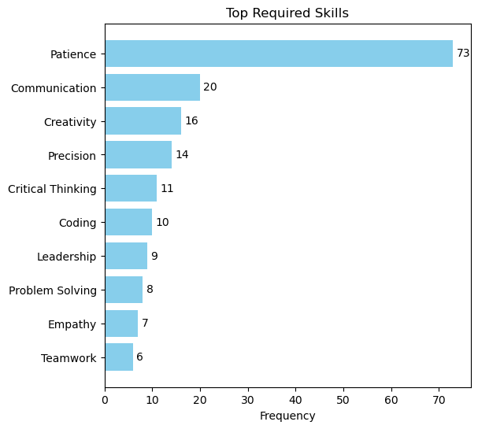
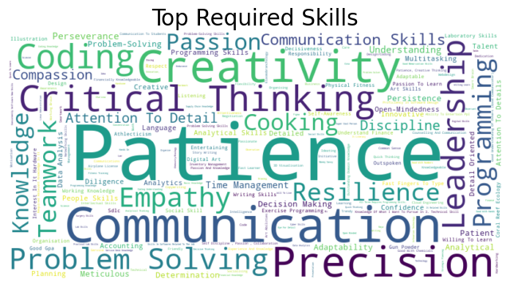
TEXT MINING - REQUIRED SKILLS
Javier
Insights: Top required skills for the jobs mentioned by all students is patience at a very high frequency of 73

Slide 58
TEXT ANALYTICS(CLUSTERING)

Slide 59
Text Clustering
Hong Da
Clustered columns: Career Options 1, Career Options 2, Career Options 3, Interested Career 1, Interested Career 2, Interested Career 3, Skills 1, Skills 2, Skills 3
Values from Career Options and Skills were clustered separately through different excel files
Clustering Algorithm: DBSCAN

Slide 60
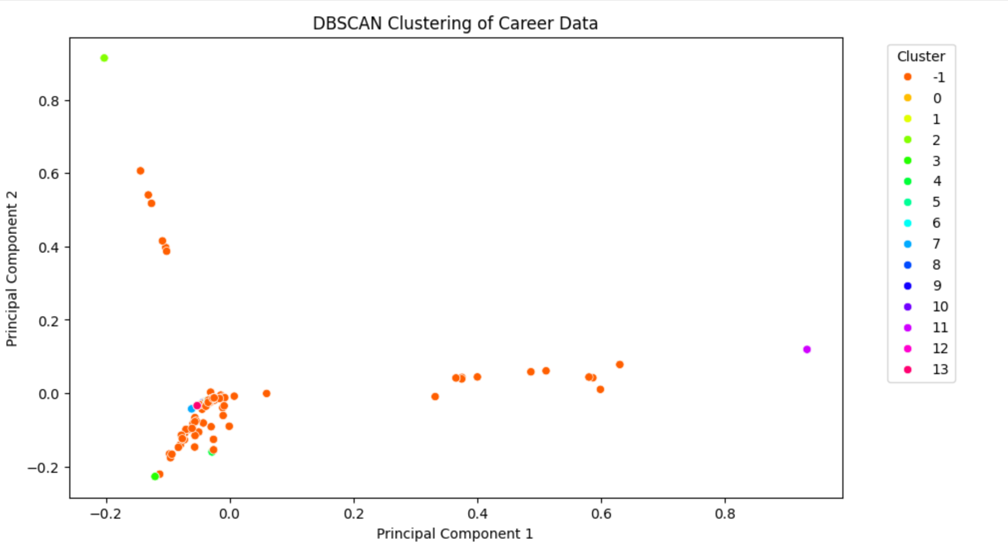
Text Clustering
Hong Da
Silhouette Coefficient: 0.17
Number of clusters: 15
Reason for low Silhouette Coefficient:
Too many noise points
Lack of data

Slide 61

Text Clustering
Hong Da
Silhouette Coefficient: 0.63
Number of clusters: 51

Slide 62
PREDICTIVE MODELLING

Slide 63
Linear Regression (Python) - Process
Javier
Select relevant columns
Convert categorical variables(yes/no) to binary
Convert columns with ranges to mean value
Impute missing value, used mean of the column
Generate polynomial features to explore non-linear relationships between features and the target variable
Partitioning of testing and training sets
Performance metric(MSE, R^2)
Actual Vs Predicted Plot

Slide 64


Linear Regression (Python) - Results
Javier
Target Variable: Absences
Variables used: Video Games(Yes/No), Game Hours, Part-Time(Yes/No), CCA Participation(Yes), School Satisfaction Level, Current GPA
MSE: 8.19
R-Square: 0.033
Insights: Underperforming Model, due to inadequate features and linear limitations, not enough data gathered, might have more relevant predictors.

Slide 65
Logistic Regression (Python) - Process
Hong Da
Binarize target variable
Independent Variables: Age, Current GPA, Desired GPA, Absences
Min-max normalizer
Test size: 0.25
Perform Logistic Regression

Slide 66



Logistic Regression (Python) - Results
Hong Da
Target Variable: School Satisfaction Level
Accuracy: 0.90

Slide 67



Logistic Regression (Python) - Results
Hong Da
Target Variable: Future Planned
Accuracy: 0.39
Possible reasons for low accuracy:
The features selected (Age, Current GPA, Desired GPA, Absences) might not be highly predictive of the target variable Future Planned.
High VIF values (32.96 and 35.22) indicate multicollinearity.
High correlation (0.76) between Current GPA and Desired GPA.

Slide 68
Logistic Regression (Knime) - Process
Hong Bin
Columns for Analysis: Age, Current GPA, Desired GPA, Absences, School Satisfaction, Future Planned
Z-Score normalizer
Convert number to String
Remove any Missing Values
80% Training Data
20% Testing Data
Random Seed: 4567

Slide 69

Logistic Regression (Knime) - Assumption
Hong Bin
VIF
All values are below 5 which indicates that the regression coefficients are stable and model would be reliable

Slide 70

Logistic Regression (Knime) - Assumptions
Hong Bin
Dark Blue squares show that the correlation is +1
Light Blue squares show correlation is +0.5
Light Red squares show correlation is -0.5
X shows there are no correlation

Slide 71

Logistic Regression (Knime) - Results
Hong Bin
The overall Accuracy of predicting if students have planned their future is 39.02%.
The prediction is not accurate as the correct prediction are less than half of the total predictions which indicates poor performance

Slide 72
Logistic Regression (Knime) - Process
Hong Bin
Columns for Analysis: Age, Current GPA, Desired GPA, Absences, School Satisfaction, Future Planned
Z-Score normalizer
Convert number to String
Remove any Missing Values
75% Training Data
25% Testing Data
Random Seed: 4567

Slide 73

Logistic Regression (Knime) - Results
Hong Bin
The overall Accuracy of predicting if students have planned their future is 35.29%.
The prediction accuracy is low with a high error rate. There is a significant imbalance in the performance across different classes. In particular, Planned class had poor performance.

Slide 74
Logistic Regression (Knime) - Process
Hong Bin
Columns for Analysis: Age, Current GPA, Desired GPA, Absences, School Satisfaction, Future Planned
Min-Max normalizer
Convert number to String
Remove any Missing Values
80% Training Data
20% Testing Data
Random Seed: 4567

Slide 75

Logistic Regression (Knime) - Results
Hong Bin
The overall Accuracy of predicting if students have planned their future is 26.83%.
The prediction is highly inaccurate. There is a significant bias towards the Undecided class while failing to predict the Planned and Not Yet classes accurately

Slide 76
Linear Regression (Knime) - Process
Daniel
Best Tuning Attempted
Columns For Analysis : Current GPA , Desired GPA , Absences , Game Hours , Game Timing , Part-Time Hours , No. Of CCAs Participated , CCA Hours , School Satisfaction Level , Support Level , Sense Of Belonging
80% Training Data
20% Testing Data
Stratified Sampling : Game Timing
Random Seed: 2345
Normalizer: Z-Score
Target Variable: Current GPA

Slide 77

Linear Regression (Knime) - Results
Daniel
Adjusted R2 Value of 0.62 which means our model is 62% Accurate when it comes to predicting A students Current GPA which is considered Good for this circumstance

Slide 78

Linear Regression (Knime) - Assumptions
Daniel
Linear Collinearity
Dark Blue squares show that the correlation is +1 whereas the correlation
Light Blue squares show correlation is 0.5
Light Red squares show correlation is -0.5
X shows there is not correlation

Slide 79

Linear Regression (Knime) - Assumptions
Daniel
VIF
Values Fit the range of < 5 which means the independent variables need not be considered of elimination

Slide 80

Linear Regression (Knime) - Assumptions
Daniel
Homoscedasticity
Shape of a random cloud with No Discernible pattern

Slide 81

Linear Regression (Knime) - Assumptions
Daniel
Normality
Residuals are normally distributed

Slide 82
Conclusion and Recommendations

Slide 83
Conclusion
Derive meaningful insights from student data covering demographics, school performance, gaming habits, part-time work, CCAs, satisfaction levels, career aspirations, and required skills.
Conducted data cleansing, visualization, clustering, and text mining to understand student behaviors and needs.
Developed predictive models to create a more responsive, effective, and student-centered educational environment.
Highlighted key patterns and trends, providing actionable insights to enhance educational strategies and student engagement.

Slide 84
Recommendations
Enhance Student’s Experience in School
Directly correlates with higher academic performance and overall, well being
Priority: High
Game Inclusive Educational Programmes
Capitalises on students’ interest to enhance the engagement and learning outcomes
Priority: Medium
Promote and Facilitate CCA Participation
Enhances student engagement and skill development
Priority: Medium
Regulate part time work
Affects student’s school performance and hard to juggle between school work, but some students might need the money
Priority: Low

Slide 85
QUESTIONS AND ANSWERS

Slide 86
THANK YOU!

